Slide 1
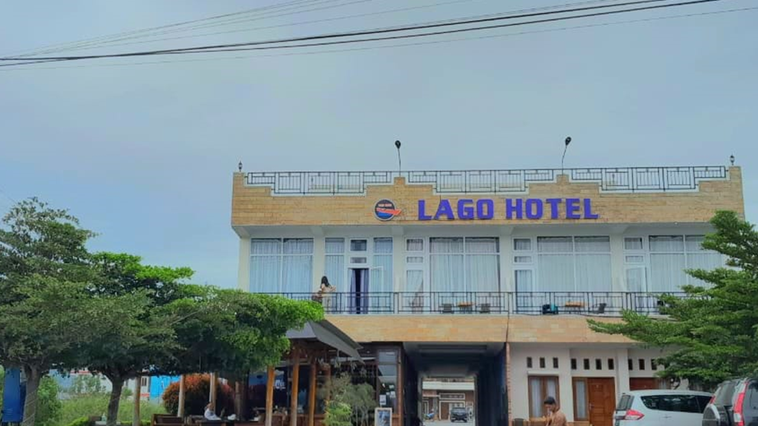


DEVELOPMENT OF LAGO
HOTEL BOOKING WEBSITE
SYSTEM
KELOMPOK 08
D3 INFORMATION STUDY PROGRAM
INSTITUT TEKNOLOGI DEL

Slide 2
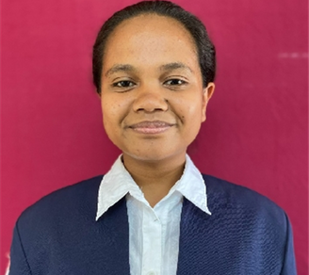
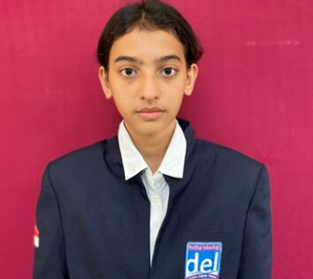
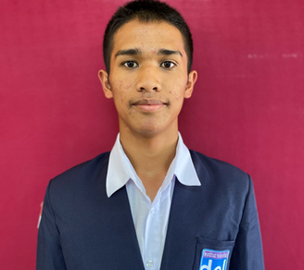
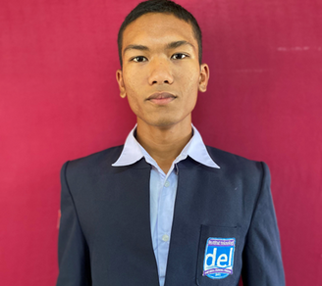
TEAM
Cecilia Limasti Cinta Situmorang
Johanna Romauli Siagian
11322041
11322061
Sabar Martua Tamba
Erlangga Abel Napitupulu
11322032
11322002

Slide 3


TABLE OF CONTENTS
Introduction
Purpose
Current System (BPMN)
Target System (BPMN)
Function on Website
Use case Diagram -> Use case Scenario
Entity Relationship Diagram Model (ERD)
Non-fungsional requirement

Slide 4
TABLE OF CONTENTS
CDM Model
PDM Model
Class Diagram
Sequnce Diagram
Test Script & Result
Analysis Result
Conclusion
Demo

Slide 5
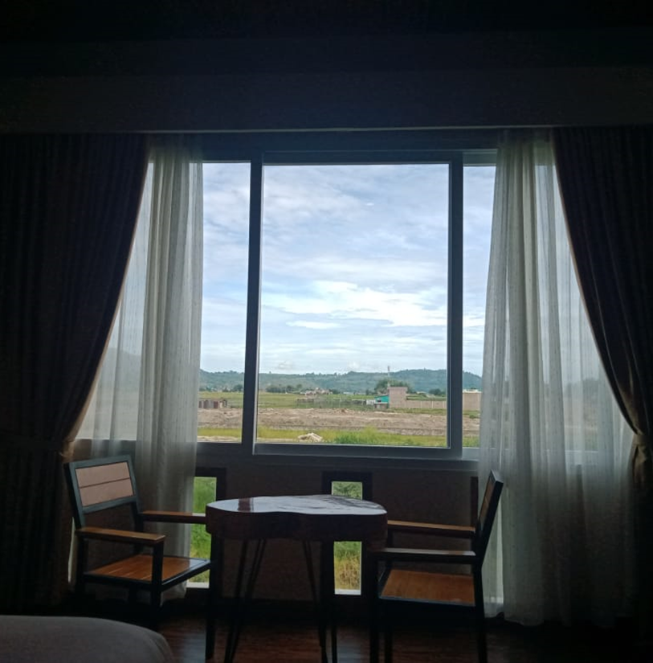
INTRODUCTION
Title
Development of Lago Hotel Booking Website System
Background
Hospitality is experiencing rapid growth
More and more people are traveling for business and leisure, and the demand for hotels is growing
With advances in technology and easy access to the internet, the way consumers book hotels has also changed. Customers do not book rooms manually but order through the online platform of the system
This demand opens up great opportunities to build hotel booking websites that can meet consumer needs effectively

Slide 6


To make it easier for customers when booking hotels
To make it easier for customers to get information about lago hotel
To make it easier for lago hotel to manage the room data available at lago hotel
PURPOSE
To make it easier for lago hotels to receive reviews about their hotels
To make it easier for lago hotel to confirm customer orders
To avoid duplicate bookings with the same room.

Slide 7

CURRENT SYSTEM (BPMN)
Development of Lago Hotel Booking Website System is still done manually with customers having to visit the hotel or book a room through the WhatsApp application by looking for the hotel owner's contact number first
After finding the contact number, the customer will contact the hotel to make a booking request
The hotel will verify the order and refuse if the requested room is not available
If the room is available, the hotel will provide information about the room, including the price and the customer will confirm that the order is correct
If the order does not match, the customer can cancel the order
After that, the hotel will provide payment information and after the customer pays, they will send proof of payment to the hotel
The hotel will record the history of reservations and prepare rooms that have been ordered by customers

Slide 8
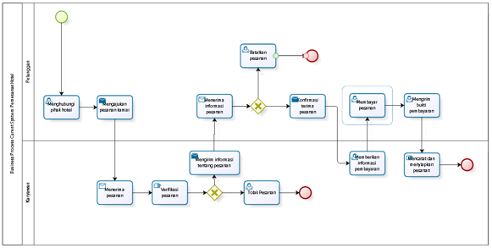
BPMN CURRENT SYSTEM

Slide 9
TARGET SYSTEM (BPMN)
Development of Lago Hotel Booking Website System is designed to make it easier for visitors or customers to get information about the rooms available in the hotel
Development of Lago Hotel Booking Website System can facilitate information search by providing clear details about each room and the facilities in the hotel
Development of Lago Hotel Booking Website System will display pictures and information about the facilities available in the hotel

Slide 10
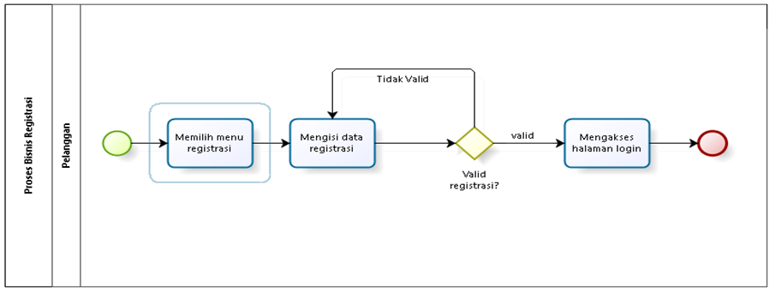

BPMN TARGET SYSTEM

Slide 11
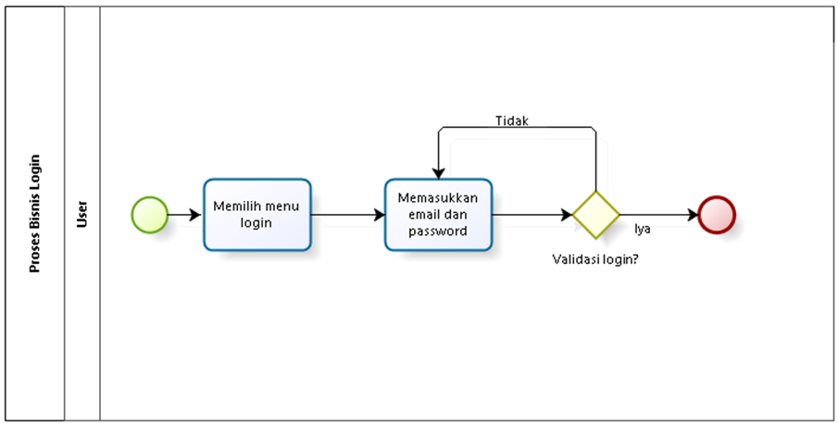
BPMN TARGET SYSTEM

Slide 12
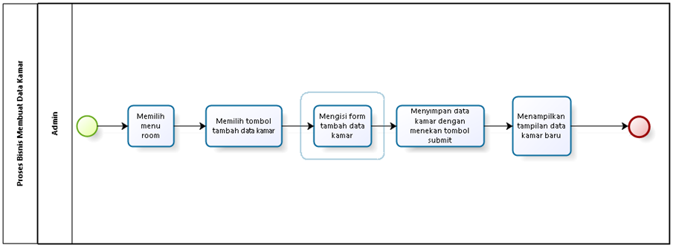
BPMN TARGET SYSTEM

Slide 13
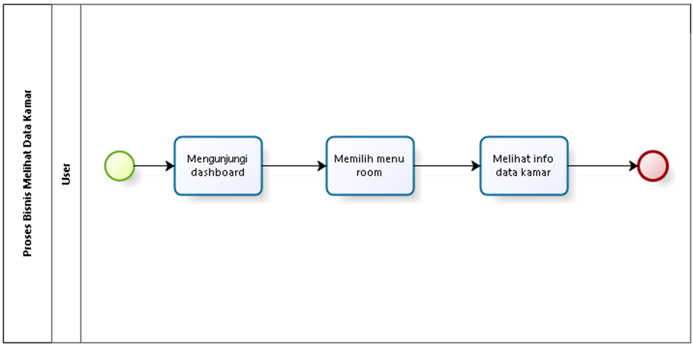
BPMN TARGET SYSTEM

Slide 14
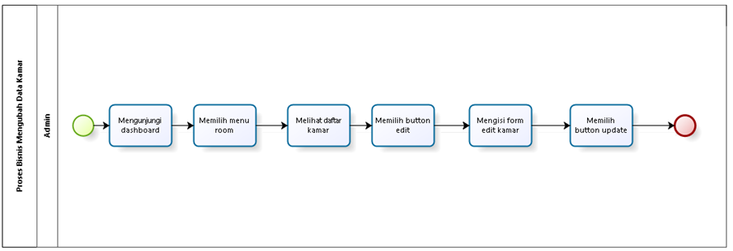
BPMN TARGET SYSTEM

Slide 15
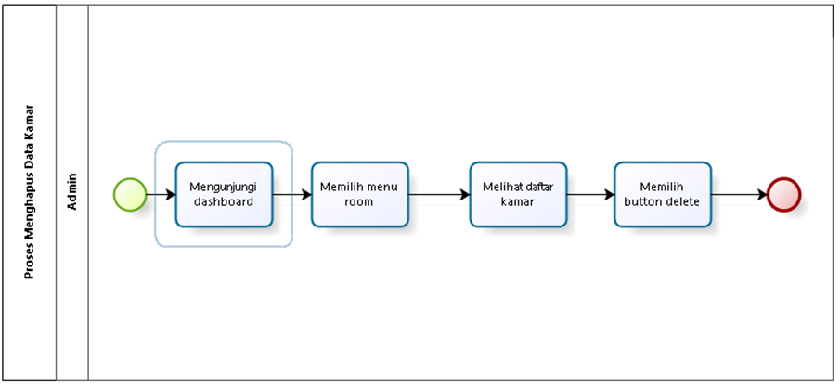
BPMN TARGET SYSTEM

Slide 16
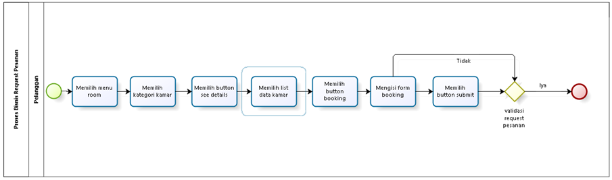
BPMN TARGET SYSTEM

Slide 17
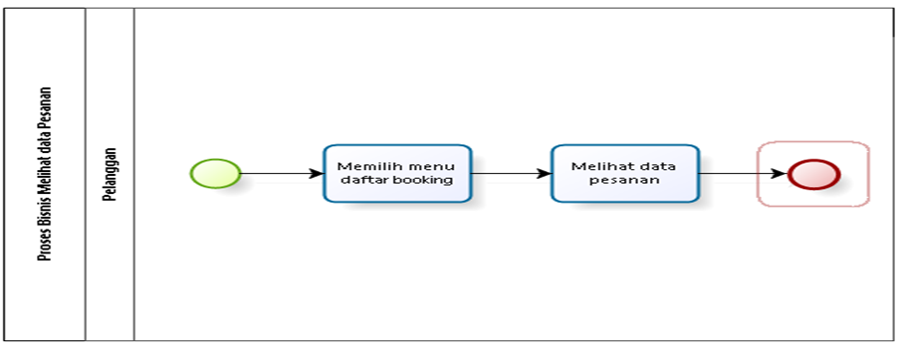
BPMN TARGET SYSTEM

Slide 18
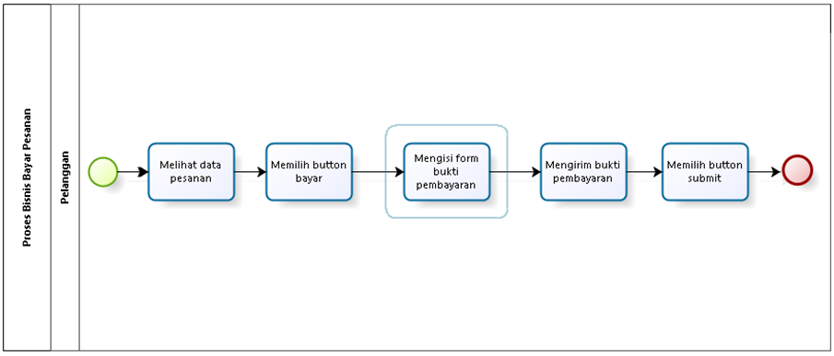
BPMN TARGET SYSTEM

Slide 19
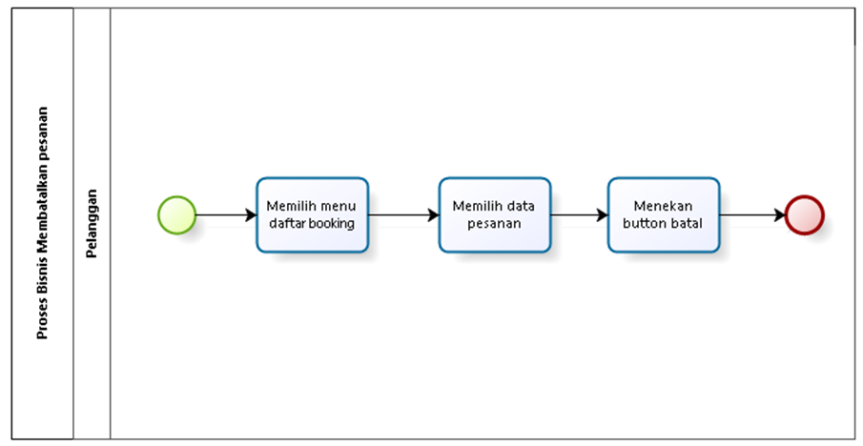
BPMN TARGET SYSTEM

Slide 20
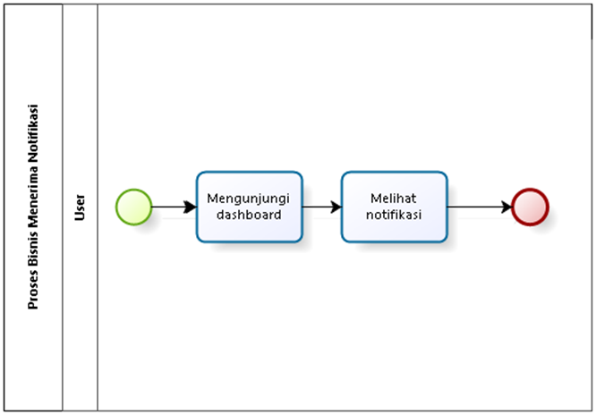
BPMN TARGET SYSTEM

Slide 21
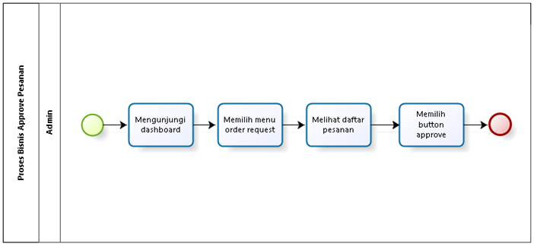
BPMN TARGET SYSTEM

Slide 22
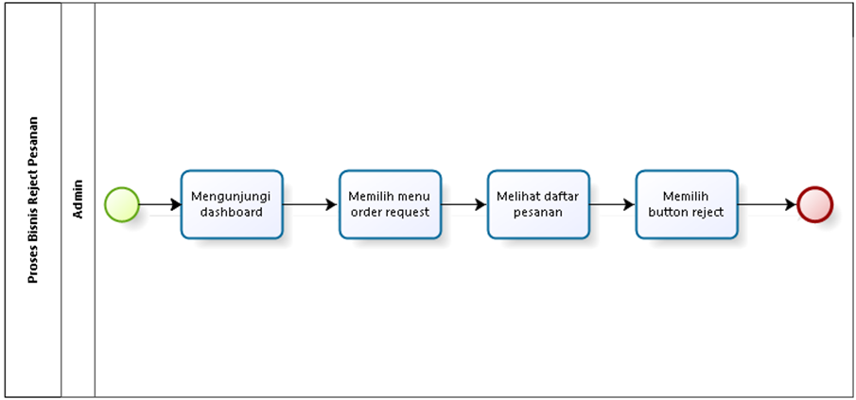
BPMN TARGET SYSTEM

Slide 23
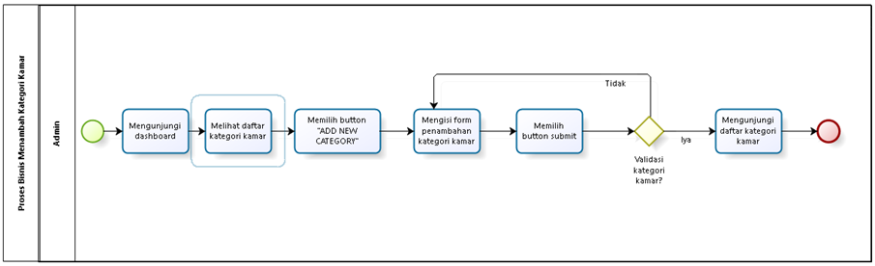
BPMN TARGET SYSTEM

Slide 24
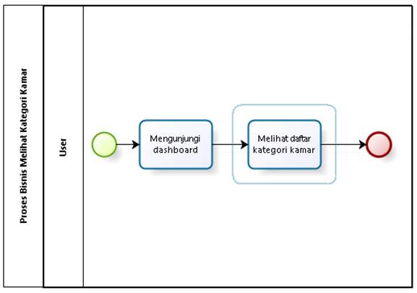
BPMN TARGET SYSTEM

Slide 25
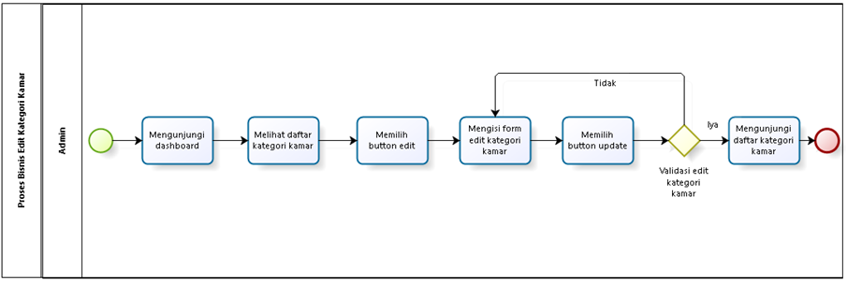
BPMN TARGET SYSTEM

Slide 26
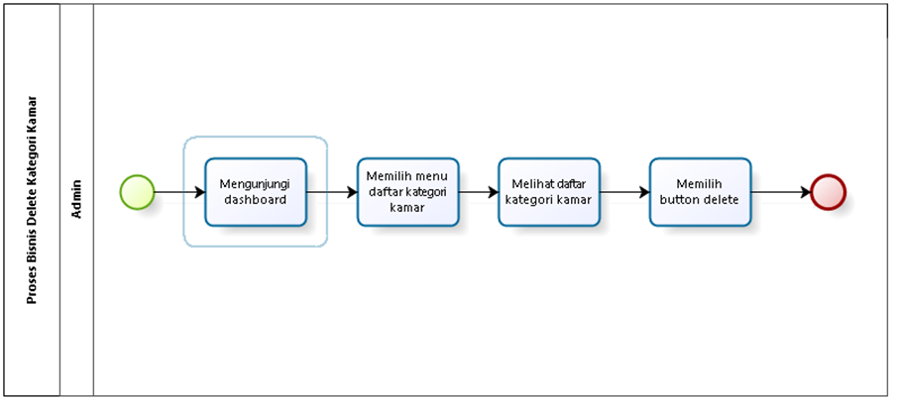
BPMN TARGET SYSTEM

Slide 27
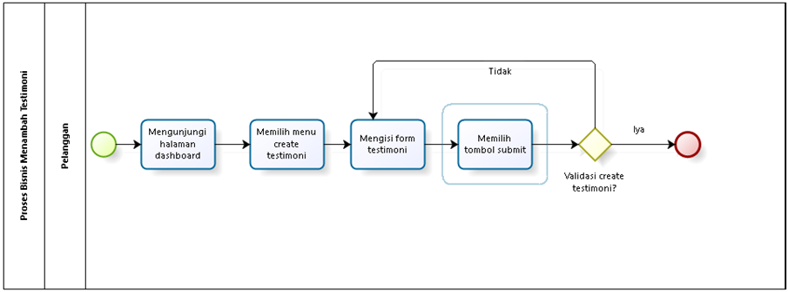
BPMN TARGET SYSTEM

Slide 28
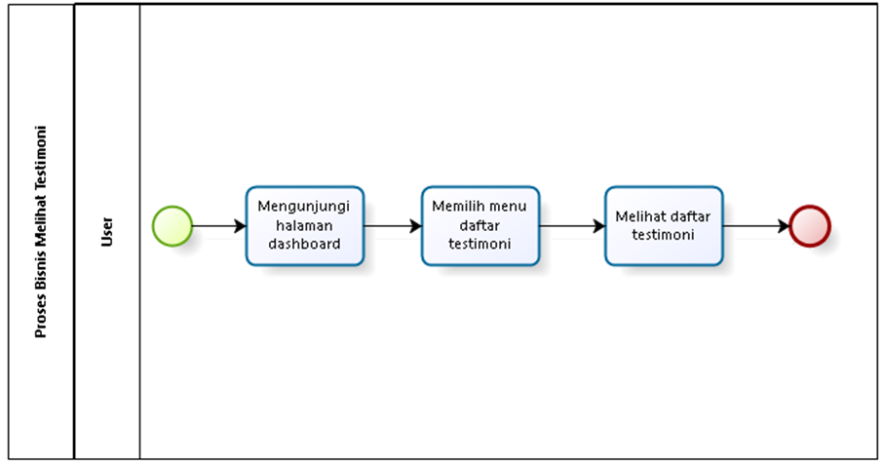
BPMN TARGET SYSTEM

Slide 29
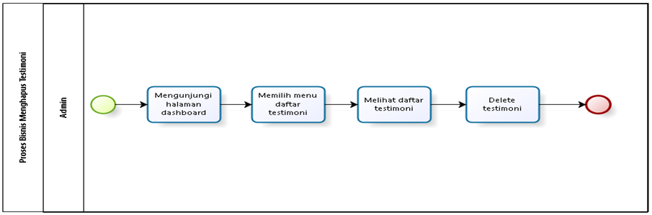
BPMN TARGET SYSTEM

Slide 30
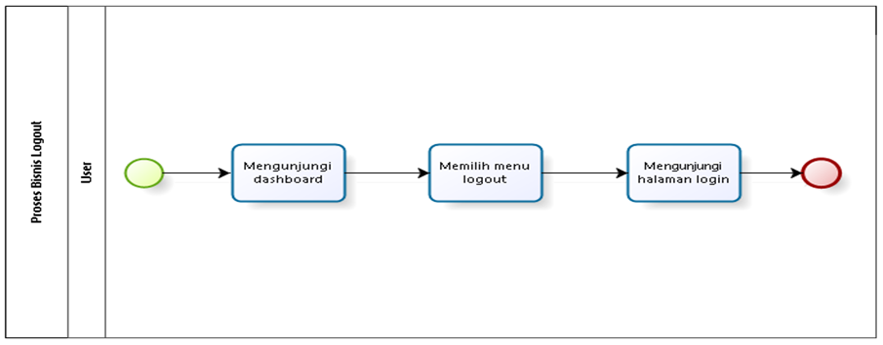
BPMN TARGET SYSTEM

Slide 31
FUNCTION ON WEBSITE
Registration
Login
Create room data
View room data
Changing room data
Delete room data
Order Request
View order data
Pay Order
Cancel Order
RECEIVE NOTIFICATION
APPROVE ORDER
REJECT ORDER
VIEW ROOM CATEGORIES
ADD ROOM CATEGORY
CHANGING ROOM CATEGORY
DELETE ROOM CATEGORY
ADD TESTIMONIAL
VIEW TESTIMONIALS
DELETE TESTIMONIAL
LOGOUT

Slide 32
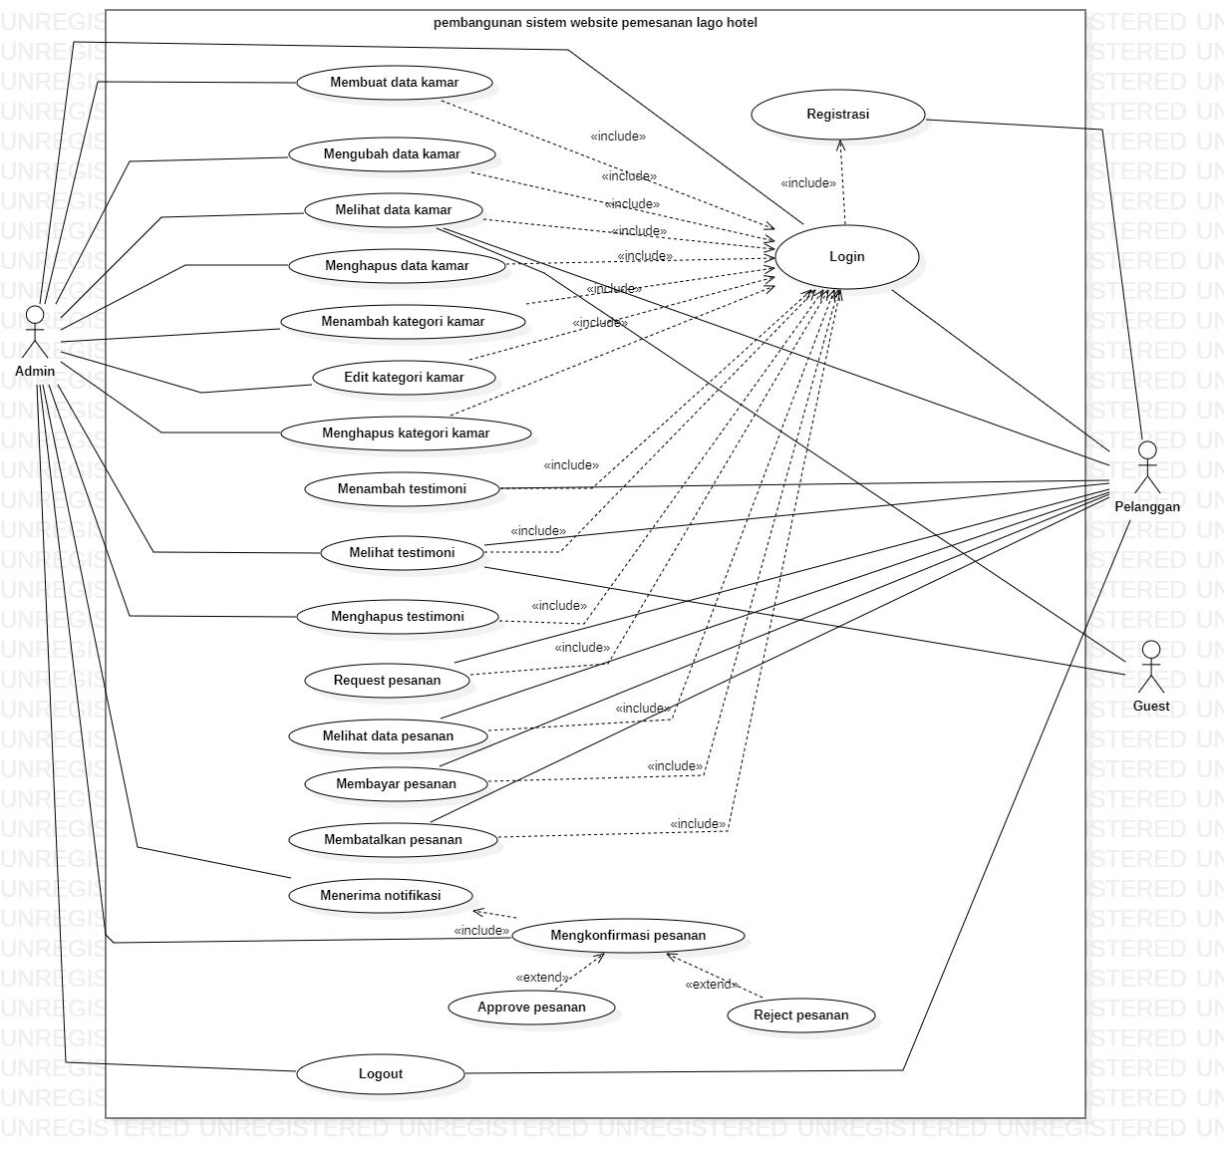
USE CASE DIAGRAM

Slide 33
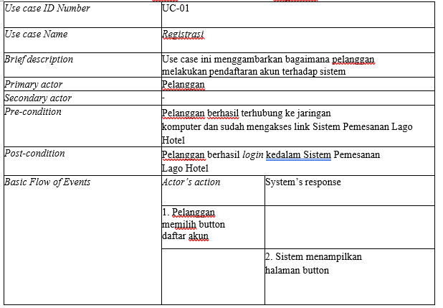
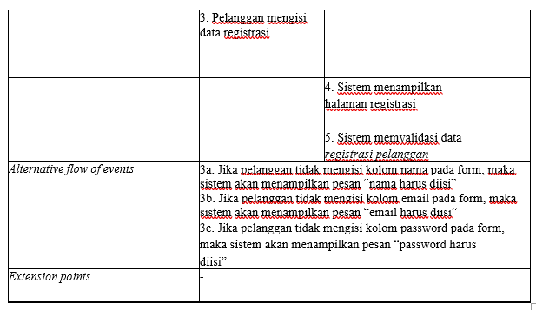
USE CASE SCENARIO REGISTRATION
Pre-condition: Customer is successfully connected to the computer network
and have accessed the Development of Lago Hotel Booking Website System link.
Post-condition: Customer successfully register in the Lago Hotel

Slide 34
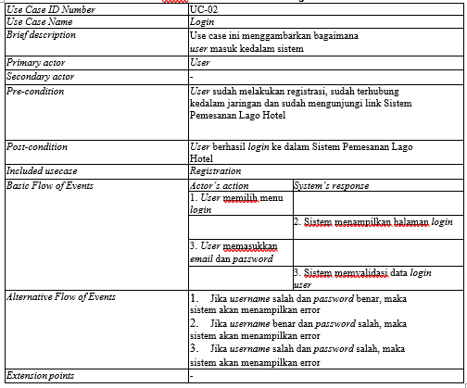
USE CASE SCENARIO LOGIN
Pre-condition: The user has registered, is connected to the network and has visited Development of Lago Hotel Booking Website System link.
Post-condition: User successfully logs into the Lago Hotel Booking System

Slide 35
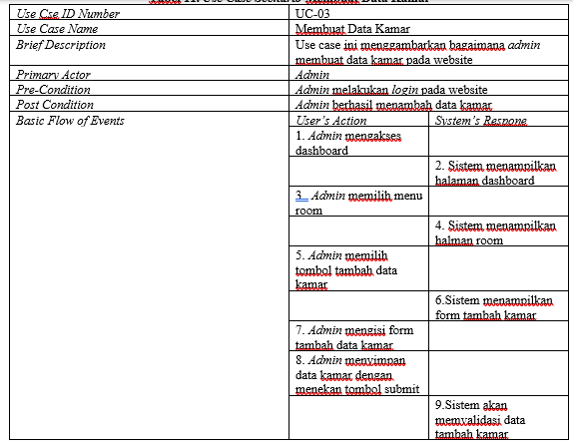
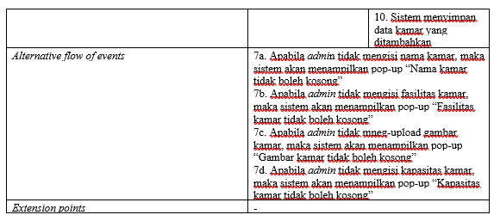
USE CASE SCENARIO CREATE ROOM DATA
Pre-condition: Admin login
Post-condition: Admin successfully add room data

Slide 36
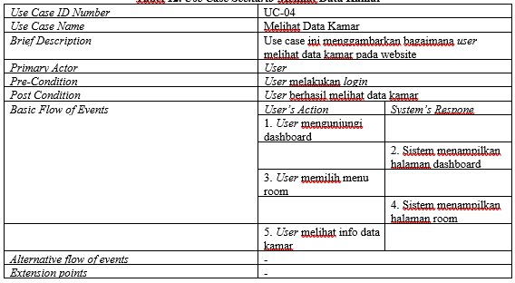
USE CASE SCENARIO VIEW ROOM DATA
Pre-condition: User login
Post-condition: User successfully view room data

Slide 37
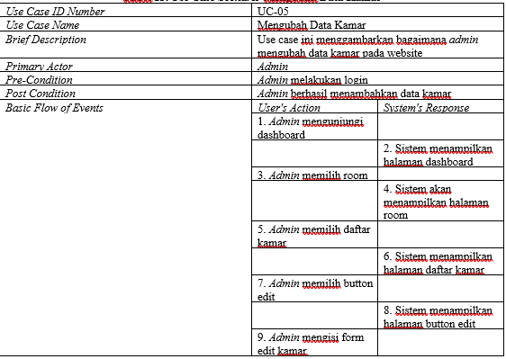
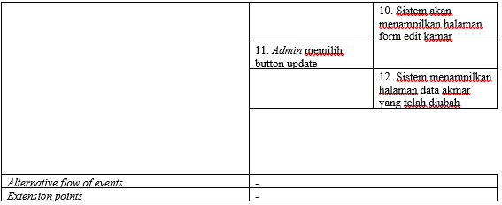
USE CASE SCENARIO CHANGE ROOM DATA
Pre-condition: Admin login
Post-condition: Admin successfully change room data

Slide 38
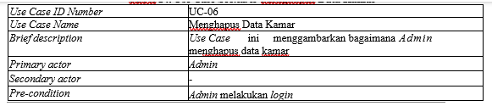
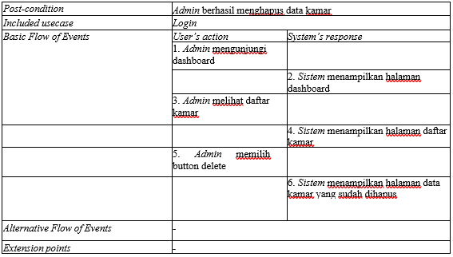
USE CASE SCENARIO DELETE ROOM DATA
Pre-condition: Admin login
Post-condition: Admin successfully delete room data

Slide 39
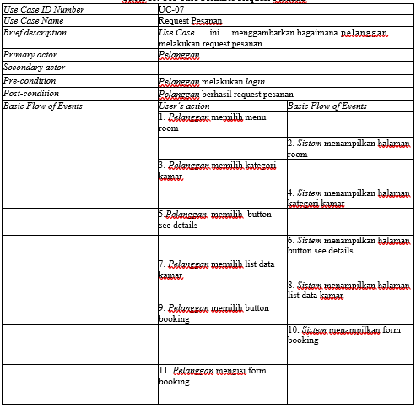
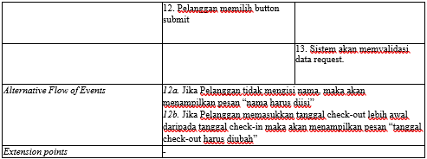
USE CASE SCENARIO ORDER REQUEST
Pre-condition: Customer login
Post-condition: Customer successfully order request

Slide 40
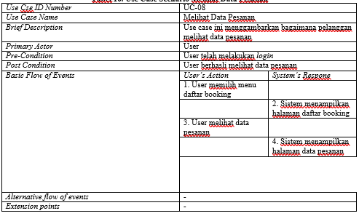
USE CASE SCENARIO VIEW ORDER DATA
Pre-condition: User login
Post-condition: User successfully view order data

Slide 41
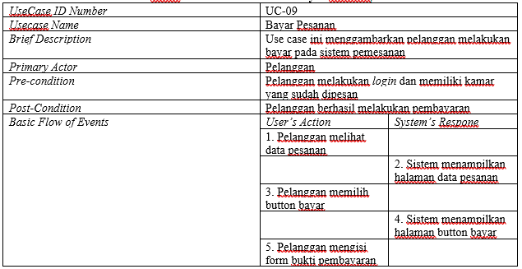
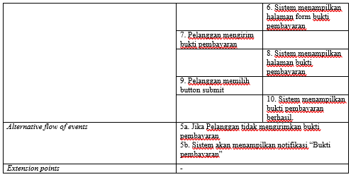
USE CASE SCENARIO PAY ORDER
Pre-condition: Customer login and has a booked room on the system
Post-condition: Customer successfully makes payment

Slide 42
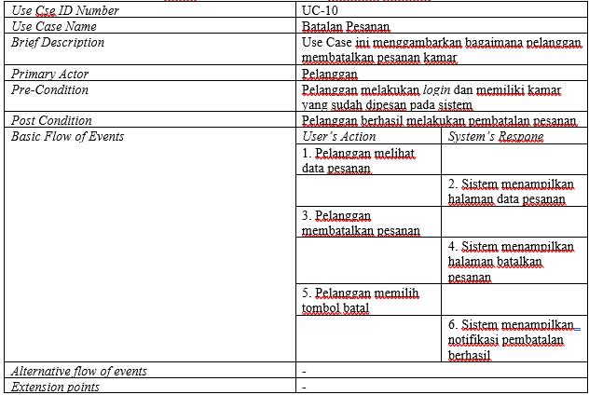
USE CASE SCENARIO CANCEL ORDER
Pre-condition: Customer login and has a booked room on the system
Post-condition: Customer successfully canceled the order

Slide 43
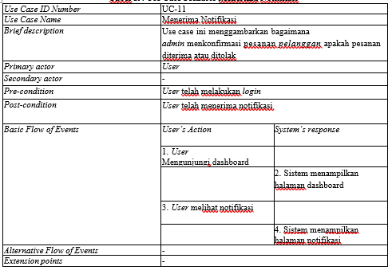
USE CASE SCENARIO RECEIVE NOTIFICATIONS
Pre-condition: User login
Post-condition: User received notification

Slide 44
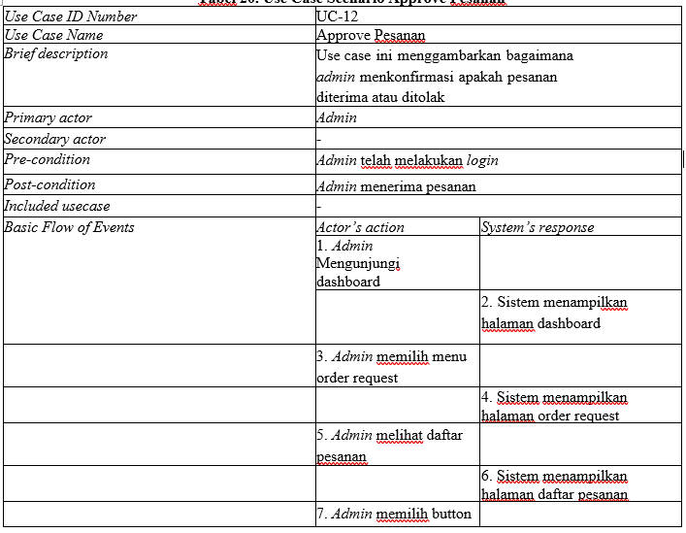
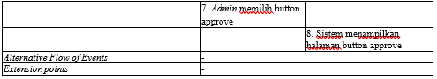
USE CASE SCENARIO APPROVE ORDER
Pre-condition: Admin login
Post-condition: Admin accepts order

Slide 45
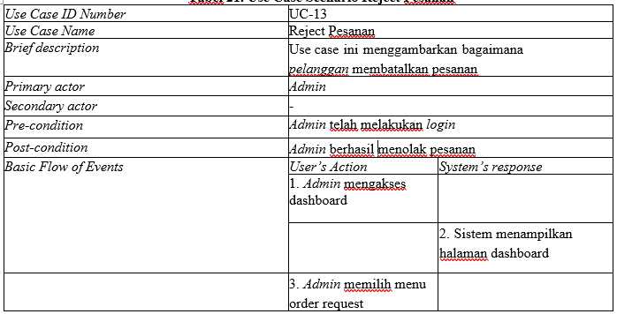
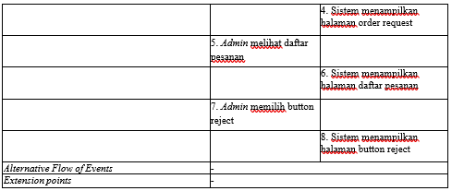
USE CASE SCENARIO REJECT ORDER
Pre-condition: Admin login
Post-condition: Admin successfully rejected the order

Slide 46


USE CASE SCENARIO ADD A ROOM CATEGORY
Pre-condition: Admin login
Post-condition: Admin successfully add a room category

Slide 47


USE CASE SCENARIO READ A ROOM CATEGORY
Pre-condition: User login
Post-condition: User successfully read a room category

Slide 48


USE CASE SCENARIO CHANGE A ROOM CATEGORY
Pre-condition: Admin login
Post-condition: Admin successfully edit room category

Slide 49


USE CASE SCENARIO DELETE A ROOM CATEGORY
Pre-condition: Admin login
Post-condition: Admin successfully delete the room category

Slide 50

USE CASE SCENARIO CREATE TESTIMONIALS
Pre-condition: Customer login
Post-condition: Customers successfully created testimonies

Slide 51

USE CASE SCENARIO READ TESTIMONIALS
Pre-condition: User login
Post-condition: User successfully view testimonials

Slide 52

USE CASE SCENARIO DELETE TESTIMONIALS
Pre-condition: Admin login
Post-condition: Admin successfully delete testimonials

Slide 53

USE CASE SCENARIO LOGOUT
Pre-condition: User login
Post-condition: User successfully logout of the system

Slide 54

ENTITY RELATIONSHIP DIAGRAM

Slide 55


NON-FUNCTIONAL REQUIREMENT

Slide 56

CDM (CONCEPTUAL DATA MODEL)

Slide 57
PDM (PHYSICAL DATA MODEL)

Slide 58

CLASS DIAGRAM

Slide 59

SEQUENCE DIAGRAM REGISTRATION

Slide 60

SEQUENCE DIAGRAM LOGIN

Slide 61

SEQUENCE DIAGRAM CREATE ROOM DATA

Slide 62

SEQUENCE DIAGRAM READ ROOM DATA

Slide 63

SEQUENCE DIAGRAM CHANGE ROOM DATA

Slide 64

SEQUENCE DIAGRAM DELETE ROOM DATA

Slide 65

SEQUENCE DIAGRAM ORDER REQUEST

Slide 66

SEQUENCE DIAGRAM VIEW ORDER DATA

Slide 67

SEQUENCE DIAGRAM PAY ORDER

Slide 68

SEQUENCE DIAGRAM CANCEL ORDER

Slide 69

SEQUENCE DIAGRAM RECEIVE NOTIFICATIONS

Slide 70

SEQUENCE DIAGRAM APPROVE ORDER

Slide 71

SEQUENCE DIAGRAM REJECT ORDER

Slide 72

SEQUENCE DIAGRAM CREATE ROOM KATEGORY

Slide 73

SEQUENCE DIAGRAM READ ROOM KATEGORY

Slide 74

SEQUENCE DIAGRAM CHANGE ROOM KATEGORY

Slide 75

SEQUENCE DIAGRAM DELETE ROOM CATEGORY

Slide 76

SEQUENCE DIAGRAM CREATE TESTIMONIALS

Slide 77

SEQUENCE DIAGRAM READ TESTIMONIALS

Slide 78

SEQUENCE DIAGRAM DELETE TESTIMONIALS

Slide 79

SEQUENCE DIAGRAM LOGOUT

Slide 80



TEST SCRIPT BUTIR-UJI-1

Slide 81


TEST SCRIPT BUTIR-UJI-2

Slide 82


TEST SCRIPT BUTIR-UJI-3

Slide 83


TEST SCRIPT BUTIR-UJI-4

Slide 84


TEST SCRIPT BUTIR-UJI-5

Slide 85

TEST SCRIPT BUTIR-UJI-6

Slide 86


TEST SCRIPT BUTIR-UJI-7

Slide 87

TEST SCRIPT BUTIR-UJI-8

Slide 88


TEST SCRIPT BUTIR-UJI-9

Slide 89


TEST SCRIPT BUTIR-UJI-10

Slide 90

TEST SCRIPT BUTIR-UJI-11

Slide 91

TEST SCRIPT BUTIR-UJI-12

Slide 92


TEST SCRIPT BUTIR-UJI-13

Slide 93

TEST SCRIPT BUTIR-UJI-14

Slide 94


TEST SCRIPT BUTIR-UJI-15

Slide 95


TEST SCRIPT BUTIR-UJI-16

Slide 96

TEST SCRIPT BUTIR-UJI-17

Slide 97


TEST SCRIPT BUTIR-UJI-18

Slide 98

TEST SCRIPT BUTIR-UJI-19

Slide 99

TEST SCRIPT BUTIR-UJI-20

Slide 100


TEST SCRIPT BUTIR-UJI-21

Slide 101

ANALYSIS RESULT
Development of Lago Hotel Booking Website System has a very attractive appearance, designed to make it easier for users to book rooms at the hotel. The following is an overview of some of the main components in the depiction of the website:
1. Home (home page) contains the main page of the website will welcome users with an attractive appearance, features in booking rooms, room categories, room prices, and complete information on the hotel.
2. Rooms contains an overview of room categories, data on rooms, prices on images, check in dates, check out dates on room bookings.
3. The booking list contains hotel room bookings, check in dates, check out dates that they have to pay.
4. Create testimony (create reviews) contains praise, criticism, suggestions, opinions made by customers to the hotel about the rooms they place.
5. View all testimony contains reviews sent by customers to the hotel.

Slide 102

CONCLUSION
Using the Development of Lago Hotel Booking Website System, customers can easily book rooms at hotels according to their needs. Customers can quickly check room availability, prices, and facilities contained in the system. This system also provides a variety of convenient payment options for customers. Prompt confirmation of orders and detailed information guaranteed to customers. In addition, this system also provides an opportunity for the hotel to collect feedback from customers to improve their services in the future. Thus, Hotel Lago's booking system provides a smooth, efficient and satisfying booking experience for hotel customers.

Slide 103

PRODUCT DEMO

Slide 104



THANK YOU

